Slide 1
Booting from hard disk…
Starting Windos 2…
Press here to boot

Slide 2

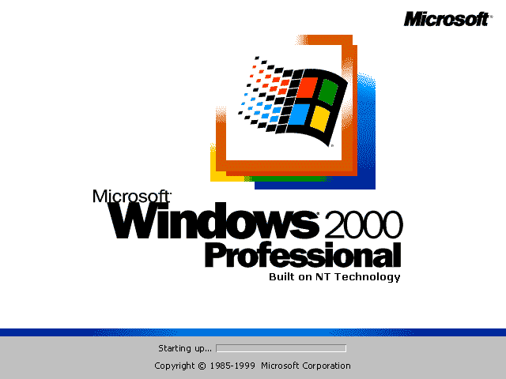

Slide 4
Memphis the virtual assistant is coming soon!
All apps
Computer
Run
Find ALPHA
Sign out
Power off
Windos 2.0
Click me to exit start menu

Slide 6
Browser 0.09
This browser is in alpha!
Wait until a later update to use it in beta/full version!
About: alpha
No Intranet

Slide 7
Find ALPHA
File to find:
Windos. exe
Look in:
All drives
This is an alpha program.
You might not get anything!
Search now

Slide 8
C:\

Slide 9

Computer
C:\

Slide 10


All apps
Power menu
browser

Slide 12
Find ALPHA result
Found:
C:\windos\system32\windos.exe
The file is 0.0001Mb in size and was created on : 23/04/2020
Open the file
exit

Slide 13
windos.exe
You cannot tun 2 instances of Windos at once, silly!
ok

Slide 14
Run
Enter the name of the program you wish to run, and Windos will run it for you:
Windos.exe
Run
Cancel

Slide 15

Power menu
Power off
restart

Slide 16
login
username
********
>

Slide 17


Windos 2
Alpha 3
For testing purposes ONLY
What’s new:
Fixed colour issue
added all apps
Added Clippy widget
Added Computer
Announcement: PowerPoint has got a very glitchy icons menu which I cannot use now ☹
Added C:\
Fixed colour issues in entire OS ☺
Added run
added find ALPHA
Added browser
Announcement: this is the last beta version!
Hint of the version:
Remember to check out all the new changes! See the widget next to me →
Trash-can
start

